Slide 1

Soccer field detection using Hough line detection
Semester- VI Project
Name:- Souradeep Das
Roll No:- 203142-21-0137
Name:- Pritam Halder
Roll No:- 203142-21-0156
Name:- Swarupananda Das
Roll No:- 203142-21-0102

Slide 2
Project overview
Currently, soccer is the most popular sport in the world, with more than
265 million players in more than 200 countries and with the largest television
audience. Thanks to this great popularity and to the technological advances produced in the last years, several artificial vision applications have been proposed.
In our project we have tried to use the concept of Computer Vision with open-cv and line detection to do line and key points detection and perform homography of the field of play in a picture snapped from a soccer match.

Slide 3
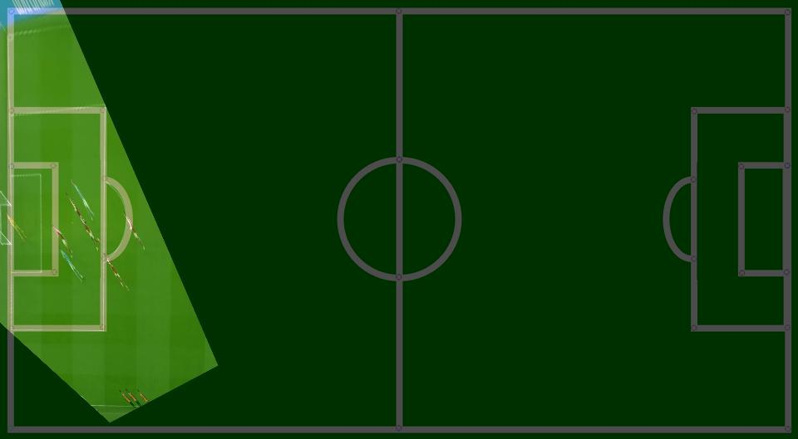
Aim
We will take an image from a football field and we will try to achieve the homography of the image with respect to a diagram of the soccer field .

Slide 4

Motivation
With soccer being the most popular sport in the world demand for new technology in the game keep on increasing VAR(Video Assistant Referee) being now one of the newest addition to the game that has now changed the sport completely apart from them we have the ball tracking , player tracking , goal line detection etcetera
And as a vivid follower and lover of the sport we decided to do our project on this topic.

Slide 5
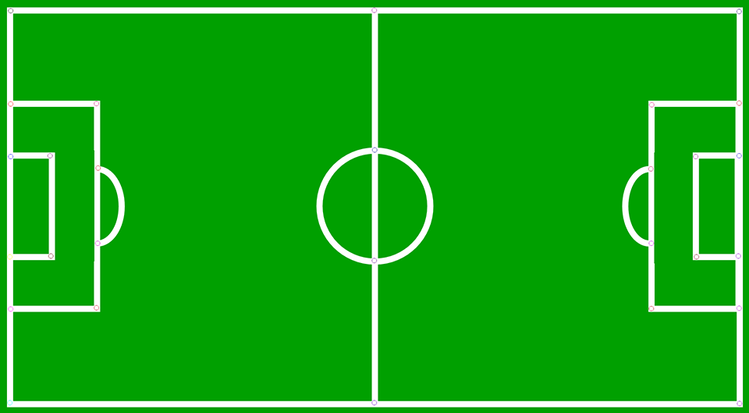
Background Information
So we are doing this project on field of football(soccer) domain.
We are also using Computer Vision(open-cv) for the purpose and we have written our code on python.
We are mainly working on the left the side of the playable football(soccer) field near the penalty box

Slide 6

Related Work

Slide 7
Problem Formulation
We have an initial football(image) taken from a game from a camera angle on the left side of the field.
We have to first do the segmentation of the image to remove the background details which are not needed so and only keep the green playable part.
After doing all kind of segmentation we will do line detection using Hough theorem.
3rd Stage will be do line classification the aim is to get 4 closed lines which will give us 4 co-ordinates that we need.
After we get all four co-ordinates on the original image we will use assumptions and try get the approx. co-ordinates for the field diagram.
And finally we have to perform homography between both images.

Slide 8
Algorithm Description
I
STAGE 1
PREPROCESSING
Ia
Ib
STAGE 3
LINE CLASSIFICATION
STAGE 2
LINE DETECTION
Ic
D
STAGE 4
KEY POINT DETECTION
STAGE 5
HOMOGRAPHY
O
K1
K2

Slide 9
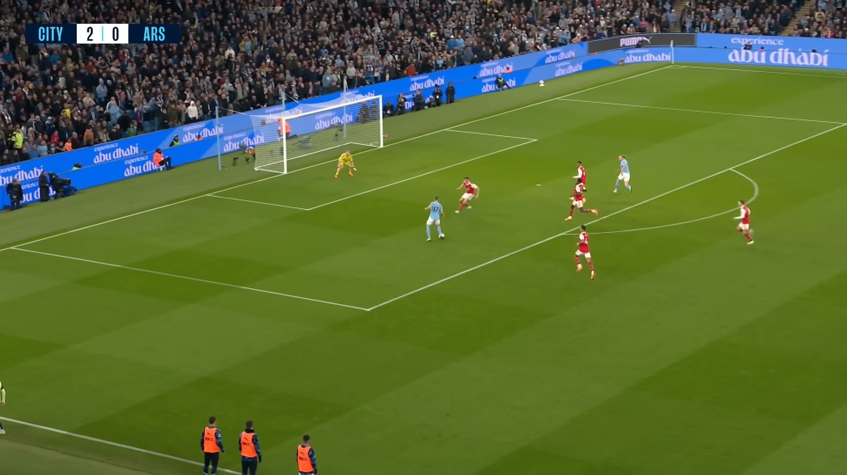
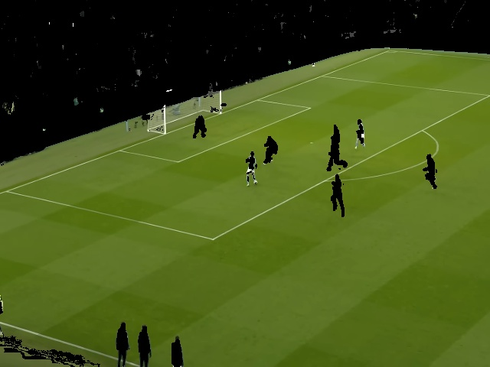
Implementation
Step 1:- Pre-processing
This is the first step where we take an input image and segment the image
After Segmenting we get the following image where we can see that non-playing parts are eliminated

Slide 10
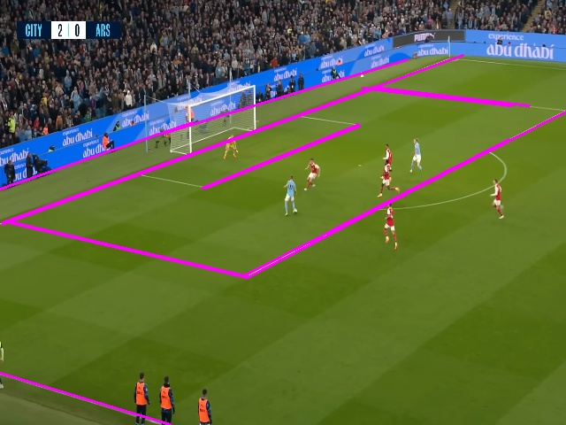
Step 2:- Line Detection
After we have segmented the image properly we move to step 2 which line detection .
Here we first use canny edge detector on the segmented image and then do Hough line detection to get the following image.

Slide 11
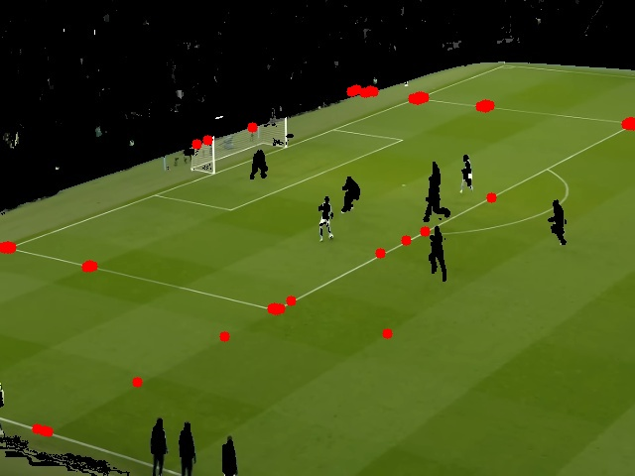
Step 3:- Line Classification
After we are done with Hough line classification the next stage is to do line classification but for that we have to find the intersection points of all the lines, and the output looks like this

Slide 12
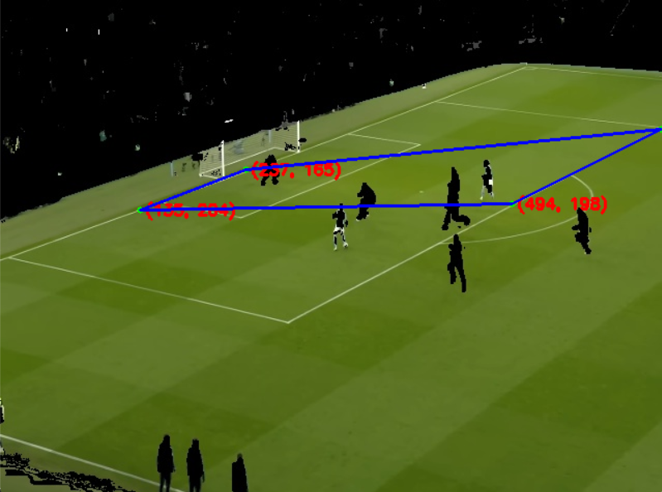
Step 3:- Line Classification(cont.)
So in last stage we got the all intersection points of the lines in the image now we have to choose only 4 co-ordinate and then we joined the 4 co-ordinate together.
In order to choose 4 co-ordinate we did used a trick here that we limited all possible co-ordinates within (0,0) and (640,480) because that is the resolution of the image we are using.
Then we took gap of 20 units(assumed) for both x and y unit between two co-ordinates
So if a co-ordinate is (0,10) next possible co-ordinate can be (20,30) any other possible co-ordinate gets eliminated.
Even after that if more than four points are still left we sort the co-ordinates in a list and then take the first element , last element and middle two elements.

Slide 13
Stage 4:- Key Points Detection
In last stage we already got key-points of original image which we stored in a list.
Now our job is predict the points for pitch diagram.
Since we are working near the left penalty box so most of the lines in the image are surrounding the box. We worked on 4 different image in some circumstances it worked.
(we can around 40% accuracy). We manually calculated the co-ordinates in this image and found that co-ordinate of the goal line in left hand side is 13 in x-axis and the straight line going through a penalty line has a co-ordinate of 126 in x-axis now since the key-points in the original image lies either in these two lines so we can consider that either they have x co-ordinate of 13 or 126

Slide 14
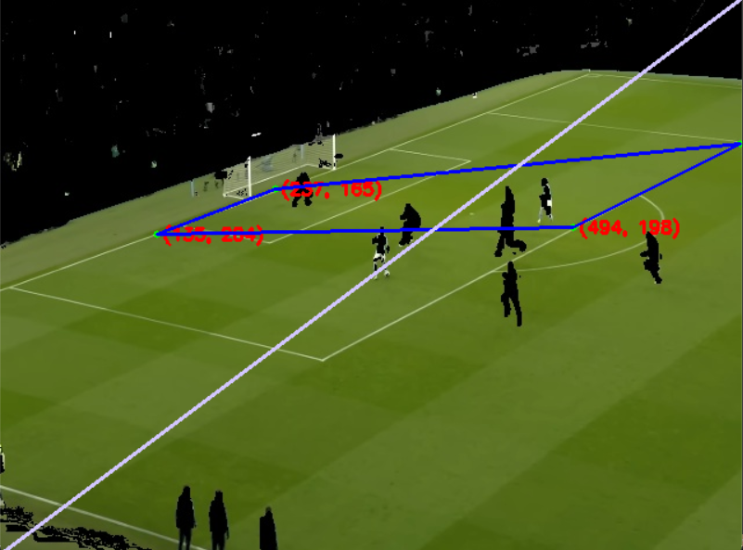
Stage 4:- Key Points Detection(cont.)
Now in last stage we came up with idea that the co-ordinate either lies in 13 or 126 x-axis in field diagram so now we have to find which co-ordinate belongs to where for that we have considered the entire image as a rectangle of 640x480 dimension and drew a diagonal line in the entire image.
Now if the co-ordinate lies in the upper adjacent layer then it will have a x value of 13 and for bottom adjacent layer x value will be 126.
Limitations:- Won’t work if all four co-ordinate lies in upper or bottom adjacent layer because different camera angle of the image (like ariel or close up shots)

Slide 15


Stage 4:- Key Points Detection(cont.)
Now that we have found x values we have to find y value which are not static as x – values and y-values can be anywhere within the range of 0 to 480.
Another thing whether it is the original spapshot the field diagram y-value always increases when we go down. So working with 5 different images manually we came with an approx. value to get y-value and considering at which angle the image x is lying.
$$y_{new}=\left\{\begin{matrix}y+200 ∀0≤x<100 \\ \begin{aligned}y+100 ∀100≤x<200 \\ y+110 200 ∀ ≤x<300 \\ y+60 ∀300≤x<400 \\ y+50 ∀400≤x<500 \\ y+10 ∀ y≥500\end{aligned}\end{matrix}\right.$$

Slide 16
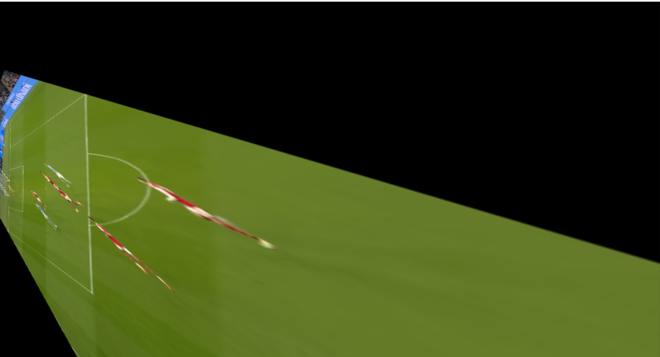
Stage 5:- Homography
Now that we have all co-ordinates we perform homography.
Using the code snippet:-
h,status = cv2.findHomography(pts_src, pts_dst)
im_out = cv2.warpPerspective(source, h, (destination.shape[1],destination.shape[0]))
The result that we are getting is:

Slide 17
Discussion
Thus My Input Was this image and output is this

Slide 18
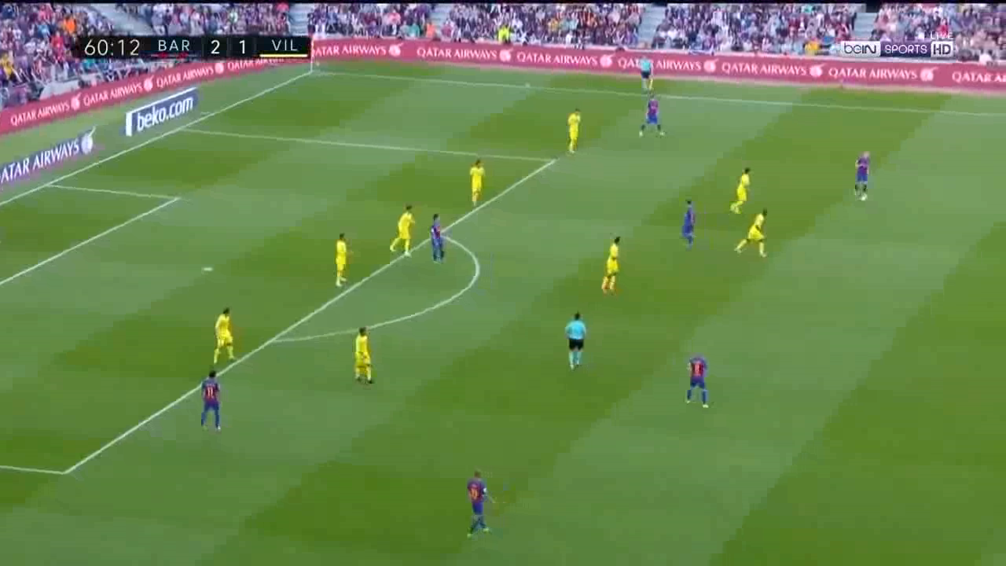
Discussion(cont.)
As this is an experiment there many images that will not work here like
Basically because entire penalty area falls on the upper adjacent side.
Similarly and other camera angle won’t work except this camera angle.

